Slide 1


Bellevue University Applied Data Science NIHS Health Survey Data Prof. Catherine Williams
Astrid Fuentes
September 2022

Slide 2
Content
The problem
Background
Data explanation
Methods
Analysis
Conclusion

Slide 3
The Problem
As a data scientist working for a life insurance company, I have been assigned to evaluate the different causes of deaths and how these have been changing throughout the years. The idea is to be able to predict if an individual with certain health conditions is more likely to die.
Diabetes
Hypertension

Slide 4
Background
NHIS is a nationally representative, cross-sectional household interview survey that serves as an important source of information on the health of the civilian, noninstitutionalized population of the United States. It is a multistage sample survey with primary sampling units of counties or adjacent counties, secondary sampling units of clusters of houses, tertiary sampling units of households, and finally, persons within households. It has been conducted continuously since 1957 and the content of the survey is periodically updated. NHIS has been used as the sampling frame for other NCHS surveys focusing on specialized populations, including LSOA II.
Prior to 2007, NHIS collected full nine-digit Social Security Numbers (SSN) from survey participants. However, in attempt to address respondents’ increasing refusal to provide SSN and consent for linkage, NHIS began, in 2007, to collect only the last four digits of SSN and added an explicit question about linkage for those who refused to provide SSN.

Slide 5
Data explanation
I will be Using the National Center for Health Statistics (NHCS) 2019 Public-Use Linked Mortality Files available for 2009-2014 NHIS. That is found in .dat format which can be easily read in R. There is one file per year with 10 variables each, including: mortality status, diabetic, hypertense, and eligibility for next year’s assessment.

Slide 6
Methods
I started using some statistical analysis to identify correlation and other statistical measurements. After that, I built a linear regression model to attempt to predict the mortality status of an individual based on the presence of underlying health issues like diabetes and hypertension. I also attempted to implement a classification model using logistic regression to predict the outcome of an individual (either Dead or Alive) based on underlying health conditions. I was unable to perform survival analysis as initially thought because there is no variable that tell us when the event occurs, like age at death or years until death.

Slide 7
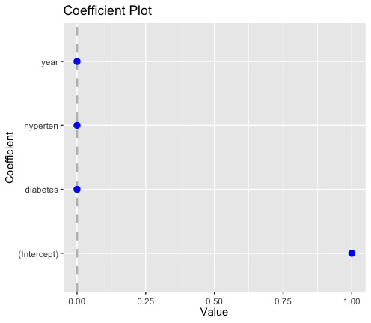
Analysis
After loading NHIS data files for 5 years (2009-2014) I combined all these in one big data file. The initial linear model proposed is as follows: model_1 <- lm(mortstat ~ eligstat + diabetes + hyperten + year, data = data) where the variables we were interested to use in predicting the mortality status were the eligibility status, diabetes, hypertension, and year. Only diabetes seems to have a statistically significant influence in the outcome of the participant with chances of non-survival being 0.191% higher for those individuals with this condition.

Slide 8
Analysis
A Kaplan Meier Model which showed the number of individuals who did not survive each year as well as the percentage of survival continued to decrease, which was expected.
Using Binary Logistic Regression, the frequency tables showed us our variables of interest are binary. After splitting the data set in train and test data to train a model, two attempts were made: one with all variables and one with a selected number of variables. Both attempts ran for a long time and finally gave a non-convergence message meaning that the function was unable to estimate parameters for the variables.

Slide 9
Conclusions
Based on the linear model we can see that diabetes has some influence in the mortality status of the individuals surveyed. The models we attempted to use to predict the mortality status were unsuccessful at this time and will require more time to be developed. It is also possible that due to the lack of important variables like the age of the participant or the number of years until death we are unable to reach a prediction model that can be useful.
The greatest limitation so far is the removal by the agency of all direct personal identifiers from analytic files and additional important variables. These public-use LMFs include a limited set of variables for adult participants only and were subjected to data perturbation techniques to reduce participant disclosure risk. Synthetic data were substituted for follow-up time or underlying cause of death for select records. The lack of crucial variables needed for survival analysis, like the age or a date of birth made it impossible to perform the modelling as initially thought.

Slide 10
Ethical Considerations
The files include a limited set of mortality variables for adult participants only. The public-use versions of the NCHS Linked Mortality Files were subjected to data perturbation techniques to reduce the risk of participant re-identification. For select records, synthetic data were substituted for follow-up time or underlying cause of death. This may limit the accuracy of the data. We have also found that the lack of age or year of birth prevents us from using a survival model.
Another ethical consideration is the fact that people could have an underlying condition of diabetes and/or hypertension and die of an unrelated cause, for example an accident. These circumstances are not being considered in my project.

Slide 11
References
Center For Disease Control and Prevention (CDC). 2019 Public-Use Linked Mortality Files. https://www.cdc.gov/nchs/data-linkage/mortality-public.htm
Center For Disease Control and Prevention (CDC). 2019 Public-Use Linked Mortality Files Data Dictionary. https://www.cdc.gov/nchs/data/datalinkage/public-use-linked-mortality-files-data-dictionary.pdf
Center For Disease Control and Prevention (CDC). 2019 Public-Use Linked Mortality Files Data Files. https://ftp.cdc.gov/pub/Health_Statistics/NCHS/datalinkage/linked_mortality/

Slide 12

Thank you for your Attention

